Slide 1
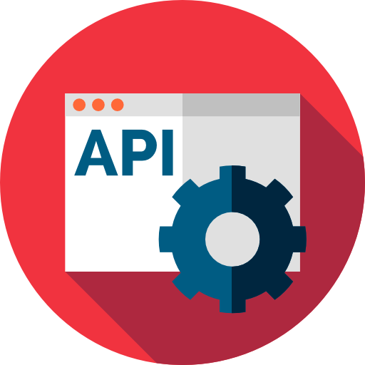
Web API
SoftUni Team
Technical Trainers
Software University
https://softuni.bg

Slide 2
Table of Contents
JSON & XML
JavaScript
AJAX & jQuery
Web Services
Web API
Web API Methods
Angular
CORS

Slide 3
Have a Question?
sli.do #csharp-web

Slide 4

JSON

Slide 5
JSON (1)
JavaScript Object Notation (JSON) is an open-standard file format
Uses human-readable text to transmit data objects
Data objects consist of attribute-value pairs or array data types
Basically any serializable value
Easy for humans to read and write
Easy for machines to parse and generate
JSON is derived from JavaScript
However, it is language-independent
Now many languages provide code to generate and parse JSON
{
"firstName": “Peter",
"courses": ["C#", "JS", "ASP.NET"]
"age": 23,
"hasDriverLicense": true,
"date": "2012-04-23T18:25:43.511Z",
// ...
}

Slide 6
JSON (2)
JSON is a very common data format used in web communication
Mainly in browser-server or server-server communication
The official internet media type (MIME) for JSON is
JSON files use the extension .json
JSON is commonly used as a replacement for XML in AJAX systems
JSON is shorter and easier to comprehend
JSON is quicker to read and write, and is more intuitive
JSON doesn't support schemas and namespaces
application/json

Slide 7
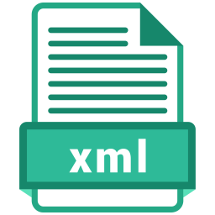
XML

Slide 8
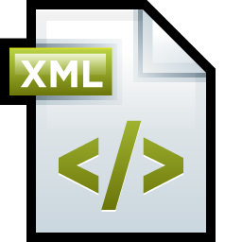
XML (1)
XML defines a set of rules for encoding documents
Stands for Extensible Markup Language
Similar to JSON
In terms of human-readability and machine-parsability
In terms of hierarchy (values within values)
XML is a textual data format
Strong support for different human languages via Unicode
The design focuses strongly on actual documents

Slide 9
XML (2)
XML has many applications
There are 2 MIME types for XML and
XML files use the extension .xml
XML has many applications
Widely-used in SOA (e.g. WCF)
Used for configuring .NET apps
Used in Microsoft Office formats
XHTML was intended to be strict HTML format
application/xml
text/xml
<?xml version="1.0" encoding="UTF-8" ?>
<records>
<record id="1">
<name>Ivo</name>
<email>ivo@softuni.bg</email>
<company>Software University</company>
</record>
<record id="2">
<name>Niki</name>
<email>admin@Nikolay.it</email>
<company>ZenCodeo</company>
</record>
</records>

Slide 10
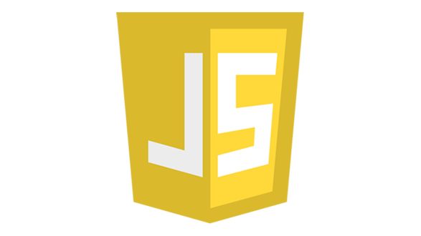
JavaScript

Slide 11
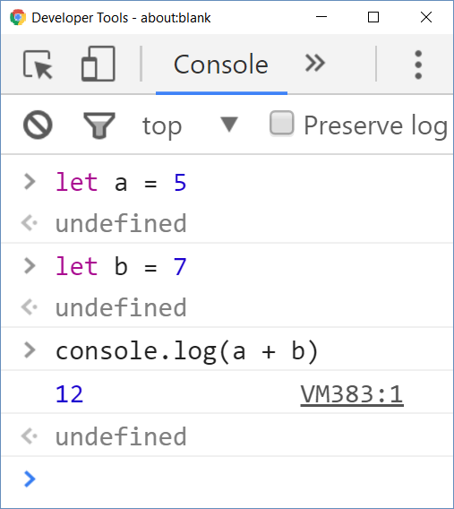
Welcome to JavaScript (1)
JavaScript (JS) is a scripting language
Executes commands (script)
Can work in interactive mode
No compilation, just execute commands
Alongside HTML & CSS, JavaScript is one of the 3 core technologies of the World Wide Web
JavaScript enables dynamics and interactivity in web pages
Has DOM and browser API (notifications, geolocation, …) access

Slide 12
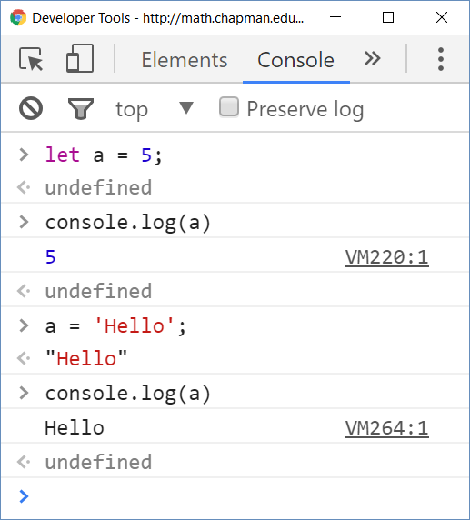
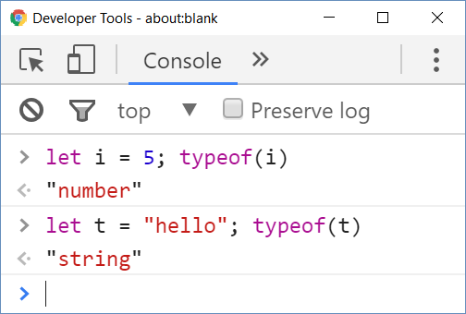
Welcome to JavaScript (2)
JavaScript (JS) is untyped language
Untyped (dynamically typed) == variables have no types (but…)
Data (values) still have a type
More Info: Link 1, Link 2, Link 3

Slide 13
Welcome to JavaScript (3)
JavaScript was initially only implemented client-side in web browsers
JavaScript engines, nowadays, are embedded in many types of software
Server-Side JavaScript, Mobile applications, Desktop Applications, etc.
JavaScript is one of the most popular technologies on the Web
If not the most popular, that is...
The rise of SPAs and JavaScript-heavy sites certainly prove that
One of the most important techniques around JS is AJAX
Asynchronous JavaScript and XML
TypeScript is a typed superset of JS that compiles to plain JS

Slide 14
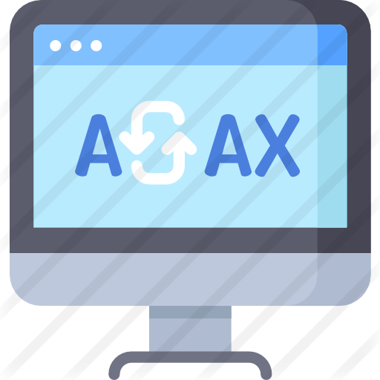
Asynchronous JavaScript and XML
AJAX

Slide 15
AJAX (1)
AJAX is not a programming language (despite its "individual" popularity)
AJAX == set of web development techniques
Used to create asynchronous web applications
Using AJAX, you can send and retrieve data to and from a server asynchronously – in the background via HTTP requests
AJAX is a developer's dream, because you can:
Read data from a web server - after the page has loaded
Update a web page (or parts of it) without reloading the page
Send data to a web server - in the background

Slide 16
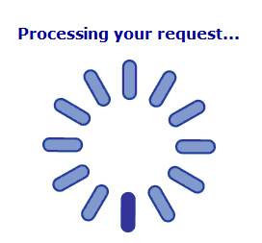
AJAX (2)
AJAX works very simply, using a combination of:
XMLHttpRequest
To request data from a server
JavaScript and DOM
To display and / or use data
AJAX is a misleading name
AJAX apps might use XML to transport data
However it is equally common to transport data as JSON

Slide 17




AJAX: Workflow
1. HTTP request (initial page load)
2. HTTP response (HTML page)
AJAX request
UI Interaction
AJAX response (asynchronous)
AJAX handler
Returns data as JSON / HTML
Web Client
Web Server
Modify the page DOM

Slide 18
AJAX in Plain JavaScript (Vanilla JS)
An AJAX Request example:
function loadHtml()
{
// Initializes a XMLHttpRequest object
let xhttp = new XMLHttpRequest();
xhttp.onreadystatechange = function() {
// readyState holds the status of the XMLHttpRequest
// (4) means Request finished and Response is ready
// status holds the status code
if (this.readyState == 4 && this.status == 200) {
// Load the Response text into the body of the document
document.body.innerHTML = this.responseText;
}
}; // Defines a function, called when the readyState Is changed
// Specify the request (method, url, async, etc...)
xhttp.open("GET", "/api/Data", true);
// Send the request to the server
xhttp.send();
}
... <button onclick="loadHtml()">
Click
</button>
...

Slide 19




AJAX in SPA
Single-Page apps are pretty common nowadays
Based on dynamic and asynchronous content changing
AJAX is pretty much used in almost every SPA
SPAs use AJAX to provide better and dynamic-data-filled apps
AJAX is used to make a smooth changes on the page
This ensures a better UX design and dynamic UI

Slide 20

jQuery
Write Less, Do More!

Slide 21
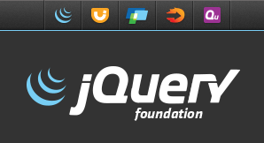
What is JQuery?
jQuery is a cross-browser JavaScript library
Dramatically simplifies DOM manipulation
Free, popular, open-source software: https://jquery.com
<script src="https://code.jquery.com/jquery-3.4.1.min.js"></script>
Load jQuery from its official CDN
$('li').css('background', '#DDD');
Change the CSS for all <li> tags

Slide 22
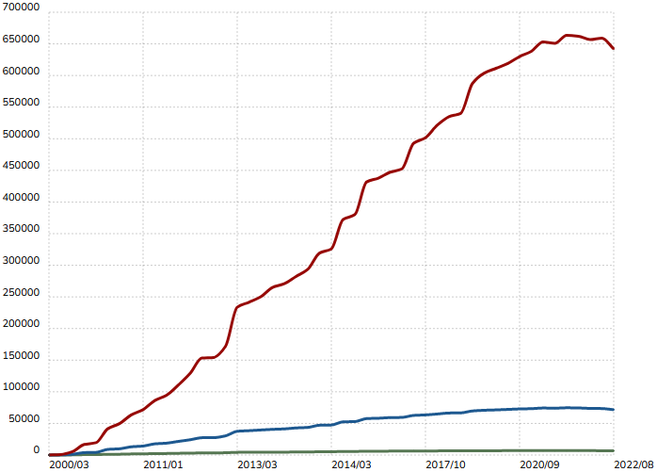
Why jQuery?
Extremely popular
83 000 000 sites use jQuery (68.8% of top 1 million sites)
http://trends.builtwith.com/javascript/jQuery
Easy to learn
Large community
Cross-browser support
Official web site: http://jquery.com

Slide 23
Selection with jQuery
jQuery's selectors return a collection of matched items
Works with CSS3 selectors with few jQuery-specific
Even if there is only one item
http://learn.jquery.com/using-jquery-core/selecting-elements/
Selected elements can be processed as a group
$('div') // Gets all elements with the provided tag
$('.menu-item') // Gets all elements with the provided class
$('#navigation') // Gets the element with the provided id
$('ul.menu li') // Gets all elements corresponding to the query selector
$('div').css('background', 'blue'); // Make all DIVs blue

Slide 24
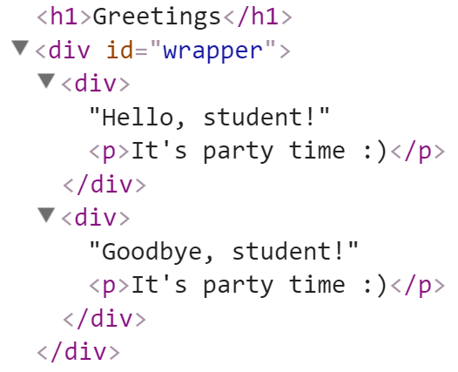
Adding Elements with JQuery
Select the parent element, then use:
append() / prepend()
appendTo() / prependTo()
<div id="wrapper">
<div>Hello, student!</div>
<div>Goodbye, student!</div>
</div>
$('#wrapper div').append("<p>It's party time :)</p>");
$('<h1>Greetings</h1>').prependTo('body');

Slide 25
Creating / Removing Elements
let div = $('<div>');
div.text('I am a new div.');
div.css('background', 'blue');
div.css('color', 'white');
$(document.body).append(div);
let paragraph = $('<p>Some text</p>');
paragraph.appendTo(div);
$('div').remove();

Slide 26
JQuery Events: Attach / Remove
Attaching events on certain elements
$('a.button').on('click', buttonClicked);
function buttonClicked() {
$('.selected').removeClass('selected');
$(this).addClass('selected');
// "this" is the event source (the hyperlink clicked)
}
Removing event handler from certain elements
$('a.button').off('click', buttonClicked);

Slide 27

jQuery AJAX
Simplified AJAX Calls with jQuery

Slide 28
JQuery vs Native XMLHttpRequest – GET
jQuery dramatically simplifies how developers make AJAX calls
$.ajax({
method: 'GET',
url: 'myservice/username',
data: { id: '42' }
})
.done(function success(data) {
alert('User\'s name is ' + data);
})
.fail(function fail(data, status) {
alert('Request failed. Returned status of ' + status);
});
var xhr = new XMLHttpRequest();
xhr.open('GET', 'myservice/username?id=42');
xhr.onload = function() {
if (xhr.status === 200) {
alert('User\'s name is ' + xhr.responseText);
}
else {
alert('Request failed. Returned status of ' + xhr.status);
}
};
xhr.send();

Slide 29
JQuery AJAX
jQuery simplifies how developers make AJAX calls
Low-Level Interface
jQuery.ajax() - Perform an asynchronous HTTP (Ajax) request
jQuery.ajaxPrefilter() - Handle custom AJAX options or modify existing options before each request is sent and before they are processed by $.ajax()
jQuery.ajaxSetup() - Set default values for future Ajax requests. Its use is not recommended
jQuery.ajaxTransport() - Creates an object that handles the actual transmission of AJAX data

Slide 30
JQuery AJAX
Shorthand Methods
jQuery.get() - Load data from the server using a HTTP GET request.
jQuery.getJSON() - Load JSON-encoded data from the server using a GET HTTP request
jQuery.getScript() - Load a JavaScript file from the server using a GET HTTP request, then execute it.
jQuery.post() - Load data from the server using a HTTP POST request.
.load() - Load data from the server and place the returned HTML into the matched element.

Slide 31
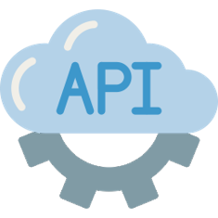
Web Services
Communication between Systems and Components

Slide 32
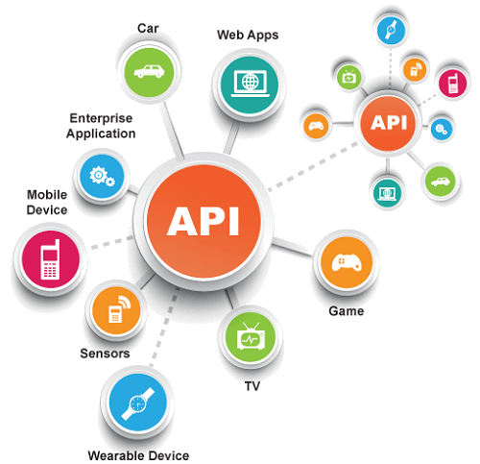
What is API?
API == Application Programming Interface
Designed for communication between system components
Set of functions and specifications that software programs and components follow to talk to each other
Examples:
JDBC – Java API for apps to talk with database servers
Windows API – Windows apps talk with Windows OS
Web Audio API – play audio in the Web browser with JS

Slide 33
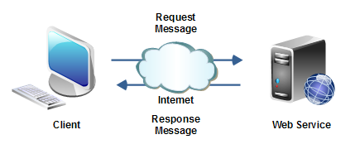
What is Web Service?
Web services implement communication between software systems or components of over the network
Using standard protocols, such as HTTP, JSON and XML
Exchanging messages, holding data and operations
All web services are APIs, but not all APIs are web services

Slide 34
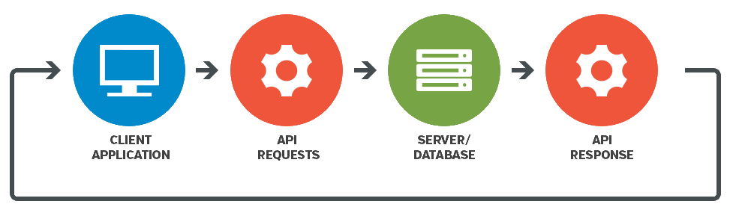
Web Services and APIs
Web services expose back-end APIs over the network
May use different protocols and data formats: HTTP, REST, GraphQL, gRPC, SOAP, JSON-RPC, JSON, BSON, XML, YML, …
Web services are hosted on a Web server (HTTP server)
Provide a set of functions, invokable from the Web (Web API)
RESTful APIs is the most popular Web service standard

Slide 35

Web API / Server-Side API
Server-Side Application Programming Interface

Slide 36

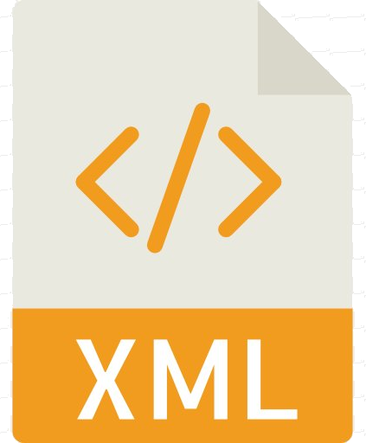
Web API / Server-Side API
Web API == application programming interface, exposed in Internet
Used by Web browsers (SPA), mobile applications, games, desktop applications, Web server, etc.
Server-side Web APIs consist of publicly exposed endpoints
The endpoints correspond to a defined request-response message system
Communication is typically expressed in JSON or XML format
Communication is typically performed over an Internet protocol
Most commonly, HTTP – through a HTTP-based web server

Slide 37
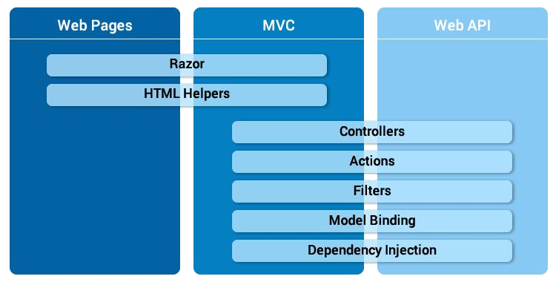
ASP.NET Core Web API
Creating a Web API with ASP.NET Core is pretty straightforward
You build controllers and they have actions
In this case though, the actions are in the role of endpoints
[Route("api/[controller]")
[ApiController]
public class ProductsController
: ControllerBase
{
...
}

Slide 38
ASP.NET Core Web API Controller
Web API controllers should:
Inherit the ControllerBase class
Be annotated with [ApiController] and [Route] attribute
[Route("api/[controller]")]
[ApiController]
public class ProductController : ControllerBase
{
private readonly IProductService productService;
public ProductController(IProductService productService)
{
this.productService = productService;
}
}
The Model and the Service can be anything. The techniques surrounding the controller are what is essential as they define the API

Slide 39

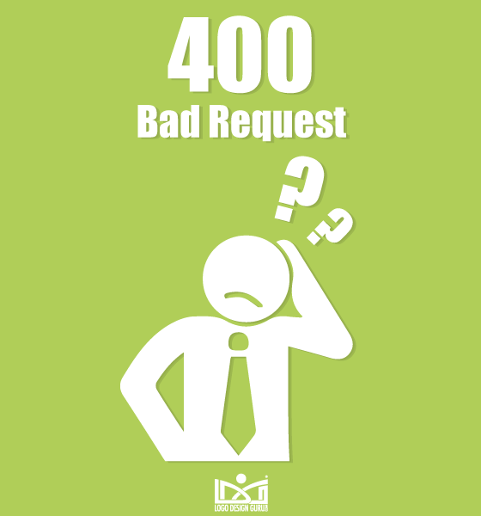

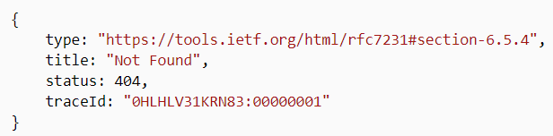

ASP.NET Core Web API (ApiController)
The [ApiController] annotation provides several convenient features
Automatic HTTP 400 responses (for model state errors)
Binding source parameter inference
Multipart / Form-data request inference
Attribute routing requirement
Problem details responses for error status codes

Slide 40
ASP.NET Core Web API (ApiController)
Automatic HTTP 400 Responses
Model validation errors automatically trigger an HTTP 400 response.
Binding source parameter inference (Binding Source Attributes)
The attributes define the location of the parameter's value
if (!ModelState.IsValid)
{
return BadRequest(ModelState);
}
This is no longer necessary
[FromQuery]
[HttpPost]
public IActionResult Create( Product product, // [FromBody] is inferred
string name) // [FromQuery] is inferred
{
}
[FromBody]
Example
[FromForm]
[FromRoute]
[FromHeader]
[FromServices]

Slide 41
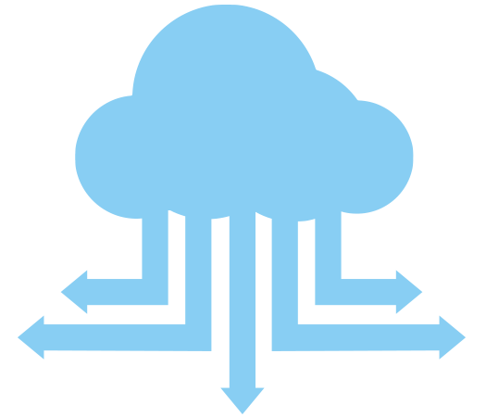
ASP.NET Core Web API (ApiController)
Multipart / Form-data request inference
Achieved by putting [FromForm] attribute on action parameters
request content type is inferred
Attribute routing requirement
Attribute routing becomes a requirement
multipart/form-data
[Route("api/[controller]")
[ApiController]
public class ProductsController : ControllerBase

Slide 42
ASP.NET Core Web API (ApiController)
Problem details responses for error status codes
Since ASP.NET Core 2.2, MVC transforms error results
Errors are transformed into ProblemDetails
ProblemDetails is:
A type based on a HTTP Api Specification for error presentation
A standardized format for machine-readable error details
{
type: "https://tools.ietf.org/html/rfc7231#section-6.5.4",
title: "Not Found",
status: 404,
traceId: "0HLHLV31KRN83:00000001"
}
if (product == null)
{
return NotFound();
}

Slide 43

ASP.NET Core Web API (ApiController)
These features are built-in and active by default
But the default behavior can be overridden
builder.Services.AddControllersWithViews()
.ConfigureApiBehaviorOptions(options =>
{
// Suppress Multipart/form-data inference
options.SuppressConsumesConstraintForFormFileParameters = true;
// Suppress binding source attributes
options.SuppressInferBindingSourcesForParameters = true;
// Suppress automatic HTTP 400 errors
options.SuppressModelStateInvalidFilter = true;
// Suppress problem details responses
options.SuppressMapClientErrors = true; // ...
});

Slide 44
ASP.NET Core Web API (Return Types)
ASP.NET Core offers several options for API Endpoint return types
Specific Type
The simplest action type
IActionResult Type
Appropriate when multiple ActionResult types are possible in the corresponding action
[HttpGet]
public IEnumerable<Product> Get()
{
return this.productService.GetAllProducts();
}
[HttpGet("{id}")]
[ProducesResponseType(200, Type = typeof(Product))]
[ProducesResponseType(404)]
public IActionResult GetById(int id)
{
var product = this.productService.GetById(id);
if (product == null) return NotFound();
return Ok(product);
}

Slide 45
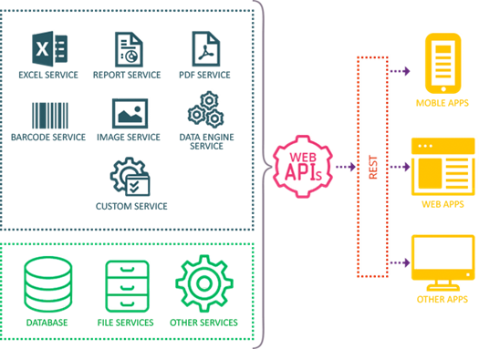
ASP.NET Core Web API (Return Types)
It is recommended to use ActionResult<T> as a return type
[HttpGet]
public ActionResult<IEnumerable<Product>> Get()
{
return this.productService.GetAllProducts();
}
[HttpGet("{id}")]
[ProducesResponseType(200)]
[ProducesResponseType(404)]
public ActionResult<Product> GetById(int id)
{
var product =
this.productService.GetById(id);
if (product == null) return NotFound();
return product;
}

Slide 46

Web API Methods

Slide 47
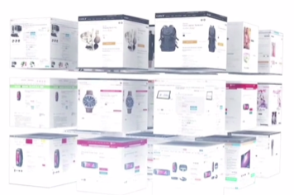
GET Methods
Creating a simple Web API with a single Controller
[HttpGet] // GET: /api/product
public ActionResult<IEnumerable<Product>> GetProducts()
{
return this.productService.GetAllProducts();
}
[HttpGet("{id}")] // GET: /api/product/5
public ActionResult<Product> GetProduct(long id)
{
var product = this.productService.GetById(id);
if (product == null) return NotFound();
return product;
}
Endpoints
GET /api/products
GET /api/products/{id}

Slide 48
POST Methods
Creating a simple Web API with a single Controller
The CreatedAtAction method:
Returns a 201 (Created) response – standart for POST requests
Adds a Location header to the response
Uses the "GetProduct" named route to create the URL
[HttpPost] // POST: api/product
public ActionResult<Product> PostProduct(ProductBindingModel productModel)
{
this.productService.RegisterProduct(productModel);
return CreatedAtAction("GetProduct", new { id = productModel.Id }, productModel);
}

Slide 49
PUT Methods
Creating a simple Web API with a single Controller
Similar to PostProduct but uses HTTP PUT
Response is 204 (No Content)
HTTP PUT requires entire updated entity
[HttpPut("{id}")] // PUT: api/product/5
public IActionResult PutProduct(long id, ProductBindingModel productModel)
{
if (id != productModel.Id) return BadRequest();
this.productService.EditProduct(id, productModel);
return NoContent();
}

Slide 50
PATCH Methods
[HttpPatch("{id}")] // PATCH: api/product/1
public IActionResult PatchProduct(int id, Product product)
{
if (this.productService.GetById(id) == null) return NotFound();
this.productService.EditProductPartially(id, product);
return NoContent();
}
Similar to PostProduct but uses HTTP PATCH
HTTP PUT requires entire updated entity, while HTTP PATCH can edit only a part of the data
Response is 204 (No Content)

Slide 51
DELETE Methods
Creating a simple Web API with a single Controller
Response is 204 (No Content)
And with this, we have our simple Products Web API
Now let's test out the Endpoints
[HttpDelete("{id}")] // DELETE: api/product/5
public ActionResult<Product> DeleteProduct(long id)
{
var product = this.productService.DeleteProduct(id);
if (product == null) return NotFound();
return product;
}

Slide 52

Angular

Slide 53
What is Angular?
Angular is a framework for building complex front-end apps
Focused on end-to-end tooling and best practices
Developed by the Angular team at Google
import { Component } from '@angular/core';
@Component({
selector: 'my-app',
template: `<h1>Hello {{name}}</h1>`
})
export class AppComponent { name = 'Angular'; }

Slide 54
Angular
Angular is rewritten on Microsoft's TypeScript language
A typed superset of JavaScript that compiles to plain JS
Any Browser! Any Host! Any OS! Anywhere! Open Source!
Angular does not have a concept of "scope" or controllers
Instead it uses a hierarchy of Components
This is its main difference from AngularJS (the first Angular)
Most modern Front-End frameworks tend to use this architecture

Slide 55

Angular Features
Cross Platform
Single Page Applications (SPA)
Progressive Web Apps
Native Mobile Apps (Cordova, Ionic)
Desktop Apps (Electron)
Great Tooling (CLI, IDEs, Templates)
Huge Community
Easy Testing, Animations, Accessibility
Can work with any back-end (Web API, Node.js, etc.)

Slide 56
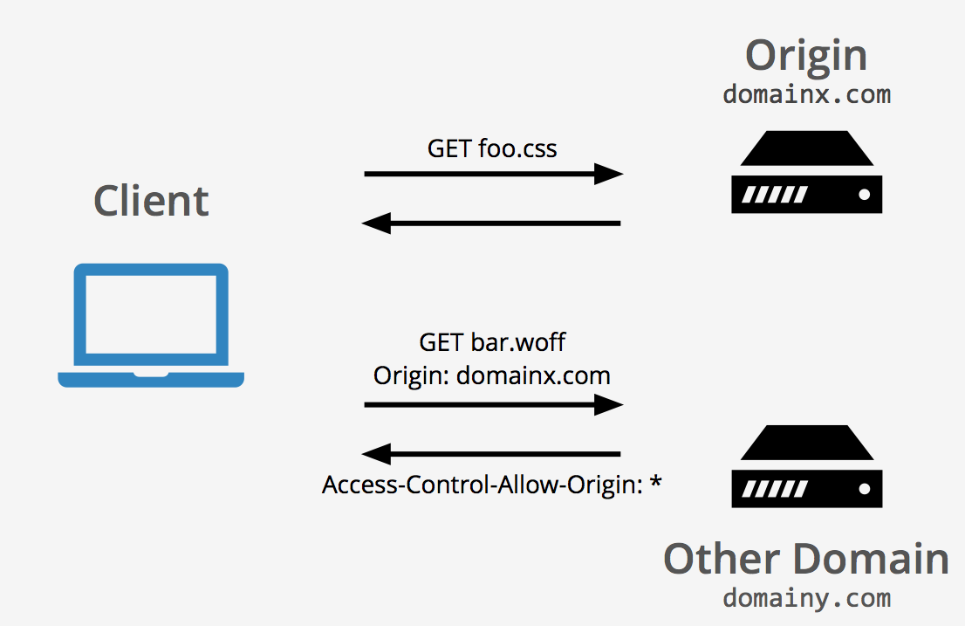
Cross Origin Resource Sharing
CORS

Slide 57
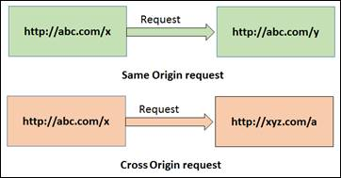
CORS (1)
Browser security prevents a web page from making requests to a domain, different from the one that served the web page (its origin)
This restriction is called Same-Origin Policy (SOP)
This policy also prevents malicious sites from reading data from your site
Sometimes you might want to allow other sites to bypass this restriction
Cross-origin requests to your app may become necessary, at some point
That's where Cross Origin Resource Sharing (CORS) comes to the rescue

Slide 58
CORS (2)
CORS is a W3C standard that allows a server to "relax" the SOP
Using CORS, a server can explicitly allow some cross-origin requests
That doesn't mean all cross-origin requests will be allowed
Two URLs have the same origin if they have
Identical Schemes, Hosts and Ports (RFC 6454)
Same-origin URLs
https://example.net
Different domain
https://www.example.com/foo.html
Different subdomain
https://example.com/foo.html
http://example.com/foo.html
Different scheme
https://example.com/bar.html
https://example.com:9000/foo.html
Different port

Slide 59
CORS Example
CLIENT
OPTIONS /resources HTTP/1.1 Host: api.example.com Origin: example.com Access-Control-Request-Method: DELETE
Access-Control-Request-Headers: Authorization
SERVER
HTTP/1.1 200 OK Access-Control-Allow-Origin: * Access-Control-Allow-Origin: DELETE
Access-Control-Request-Headers: Authorization
DELETE /resources HTTP/1.1 Host: api.example.com Origin: example.com Authorization: Bearer…

Slide 60
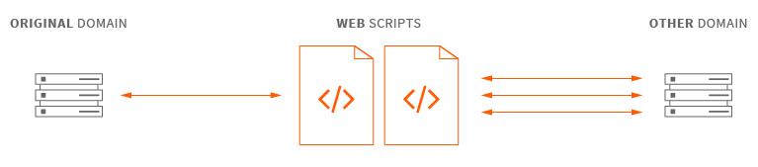
CORS in ASP.NET Core
CORS, in ASP.NET Core, is setup
Globally, via a middleware
Per Action or per Controller via an Attribute
[HttpGet]
[EnableCors("AllowSpecificOrigin")]
public ContentResult GetTest()
{
return Content("test");
}
builder.Services.AddCors();
[HttpGet]
[DisableCors]
public string Version()
{
return "1.0.0";
}
app.UseCors(builder =>
builder.WithOrigins("http://example.com"));

Slide 61

Summary
JSON & XML
JavaScript
AJAX
jQuery
Web Services
ASP.NET Core Web API
Methods
Angular
CORS
…
…
…

Slide 62
Questions?
Notes:
62

Slide 63













SoftUni Diamond Partners

Slide 64

Educational Partners

Slide 65
Trainings @ Software University (SoftUni)
Software University – High-Quality Education, Profession and Job for Software Developers
softuni.bg, softuni.org
Software University Foundation
softuni.foundation
Software University @ Facebook
facebook.com/SoftwareUniversity
Software University Forums
forum.softuni.bg
Notes:
65

Slide 66

License
This course (slides, examples, demos, exercises, homework, documents, videos and other assets) is copyrighted content
Unauthorized copy, reproduction or use is illegal
© SoftUni – https://softuni.org
© Software University – https://softuni.bg
Notes:
66

